Slide 2
Hydroelectric Power
Physics Class - March 12, 2018
Maclean Kelley, Locke Meyer, Matthew Tritschler, and Miles Diekemper

Slide 3
About Hydroelectric Power and Equations
Gravitational potential energy at the top of the waterfall provides the main source of energy U_{g} = mgh
Power, the rate of change of the potential energy, can be calculated with P = mgh/∆t = ρ∆Vgh/∆t = ρQgh

Slide 4
A Hydroelectric History Lestic (Lesson)
- 1700’s - Americans used hydropower for milling and pumping
- early 1900’s - hydropower made up 40% of the nation’s electricity
- modern times - hydropower makes up about 10% of all electricity

Slide 5
How does it work?

Slide 6
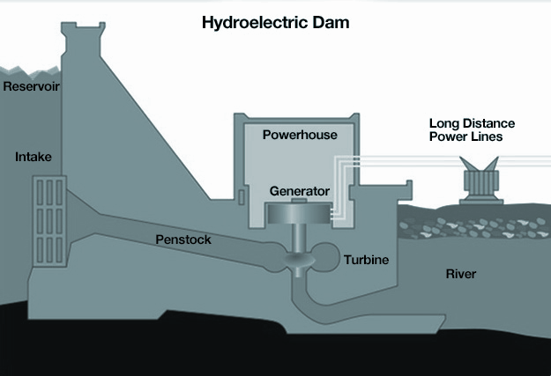
Impoundment Plant

Slide 7
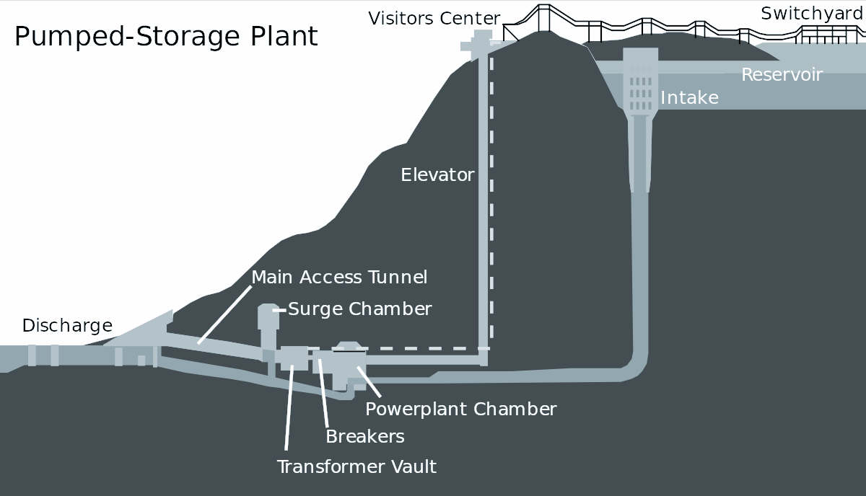
Pumped-Storage Plant

Slide 8
Diversion Plant

Slide 9
Advantages
Water is a renewable resource
Clean energy (no pollutants or greenhouse gases emitted)
Water reservoirs formed can be used for recreational purposes or irrigation
High efficiency (about 90%)
Power output can be adjusted based on demand (less at night, more during the day)
Inexpensive (about $69/kWh, as compared to $400/kWh for oil-fired generators)

Slide 10
Disadvantages
Some negative environmental consequences (fish blocked from their houses, water quality can decrease, dam building causes upstream flooding)
Stations are expensive to initially build
Limited amount of locations where facilities can be built
Risk of flooding in downstream communities

Slide 11
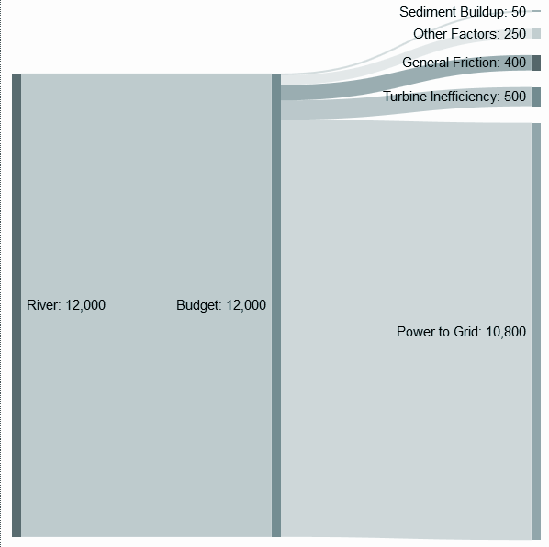
the Sankey Diagram
- very little power is lost during the processing of the energy
- modern hydroelectric power plants have about 90% efficiency
- fossil fuel processing facilities tend to be 40%

Slide 12
Credits
Sources
Locke Meyer
Maclean Kelley
Miles Diekemper
Matthew Tritschler
https://www.e-education.psu.edu/earth104/node/1067
https://www.energy.gov/eere/water/pumped-storage-hydropower
http://www.aurorapower.net/alternative-energy/hydro.aspx
://pngimg.com/download/59539
https://www.usgs.gov/special-topic/water-science-school/science/hydroelectric-power-how-it-works?qt-science_center_objects=0#qt-science_center_objects
https://science.howstuffworks.com/environmental/energy/hydropower-plant1.htm
https://www.conserve-energy-future.com/pros-and-cons-of-hydroelectric-power.php
https://commons.wikimedia.org/wiki/File:Hydroelectric_Sankey_Diagram.png
https://www.mpoweruk.com/hydro_power.htm
Dr. Stone Season 2 episode 21

